Slide 1
11- Iterables

Slide 2
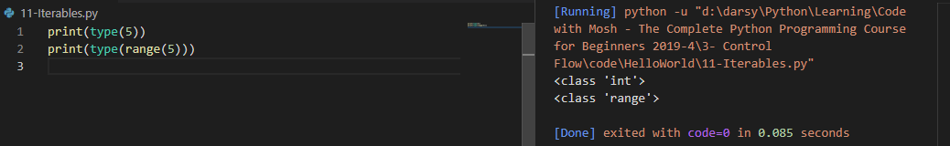
range function returns an object of type range

Slide 3
in python we have primitive types like numbers, strings and booleans.
But we also have complex types.

Slide 4
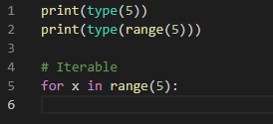
Range is an example of one of those complex types.
this range function returns a range object Which is iterable which means we can iterate over it
range objects are not the only iterable objects in python.

Slide 5
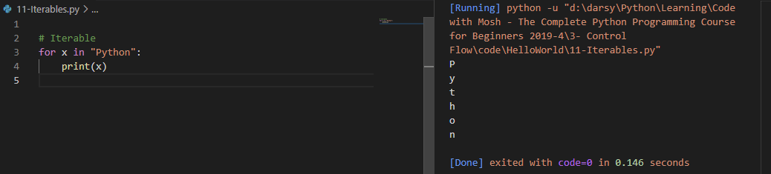
Strings are also Iterable.
in each iteration X will hold one character in the string

Slide 6
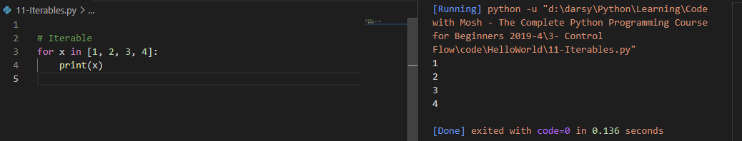
another complex type called list.
which we used to store a list of objects.
Square brackets, This indicates a list.
As you can see, we can iterate over lists. In each iteration we'll get one object in this list

